Slide 1
<?='Memory usage in PHP';?>
Have you ever wondered what happens at the engine level when a variable is created? How about when the variable is copied to another or when a function returns a variable "by reference"?

Slide 2
Variables
Hash Table Symbol Table
Zval Container
Unset() vs NULL
Functions
"Copy on write reference set"
Foreach

Slide 3
Garbage Collector

Slide 4
Variables
Every computer language needs some form of container to hold data - variables; Variables in PHP do not have statically-type attaching; They can be a string in one line, but a number in the next line.
/* The loosely-typed variables are one of the properties that make PHP such an easy powerful language, although they can sometimes also cause interesting problems; */
In PHP variables are all stored in container, called zval container and in symbol table.

Slide 5
Symbol table
Each variable name in PHP points to a zval container. Variable name, are also known as Symbols are stored in Symbol table. There is one table per scope.
PHP has three different variable scopes:
Global
Local (declared within a function)
Static

Slide 6
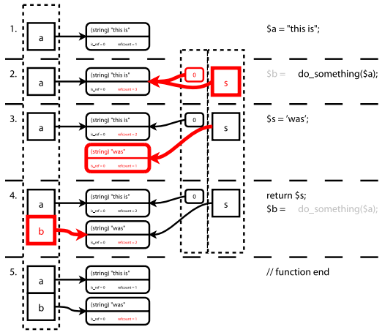
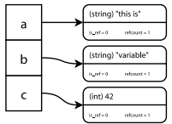
Symbol table, zval container

Slide 7
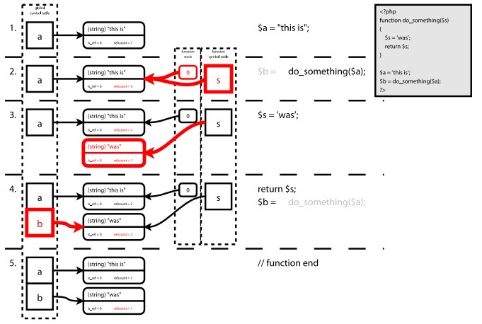
Symbol table in scopes

Slide 8
unset() vs null
"Casting a variable to null will remove the variable and unset its value.“
$foo = ‘bar‘;
$foo = (unset) $foo; // or $foo = null;

Slide 9
unset()
unset() is not a function. unset() is language construction like if.

Slide 10
F()
memory_get_usage();
memory_get_peak_usage();
memory_limit();
debug_zval_dump();
xdebug_debug_zval(); // http://xdebug.org/
get_defined_vars()

Slide 11
echo memory_get_usage();
$foo = 'bar';
echo memory_get_usage(); // 334904 bytes
$foo = null;
echo memory_get_usage(); // 335704

Slide 12
echo memory_get_usage();
$foo = 'bar';
echo memory_get_usage(); // 334904
unset($foo);
echo memory_get_usage(); // 335624

Slide 13
debug_zval_dump();
$foo = 'bar';
debug_zval_dump($foo);
> string(3) "bar" refcount(1)
$bar = $foo;
debug_zval_dump($foo);
> string(3) "bar" refcount(2)

Slide 14
xdebug_debug_zval();
$foo = 'bar';
xdebug_debug_zval('foo');
> foo: (refcount=1, is_ref=0)='bar'
$bar = $foo;
xdebug_debug_zval('foo');
> foo: (refcount=2, is_ref=0)='bar'

Slide 15
xdebug_debug_zval();
$foo = 'bar';
xdebug_debug_zval('foo');
> foo: (refcount=1, is_ref=0)='bar'
$bar = $foo;
xdebug_debug_zval('bar');
> bar: (refcount=2, is_ref=0)='bar'

Slide 16
xdebug_debug_zval();
$foo = 'bar';
xdebug_debug_zval('foo');
> foo: (refcount=1, is_ref=0)='bar'
$bar = $foo;
xdebug_debug_zval('foo');
> foo: (refcount=2, is_ref=0)='bar'
$foo = 'foo';
xdebug_debug_zval('foo');
> foo: (refcount=1, is_ref=0)='foo'
xdebug_debug_zval('bar');
> bar: (refcount=1, is_ref=0)='bar'

Slide 17
"Copy on write reference set"
PHP has a copy on write mechanism. When PHP is going to change a variable, it will check its zval.refcount > 1, PHP will create a new zval, descrease the old zval.refcount by 1, and modify the symbol table so that $name and $fname is refering to different zval.

Slide 18
"Copy on write reference set"
$name = ‘dexter’;
$fname = $name;
$name = ‘Morgan’;

Slide 19
"Copy on write reference set"
$name = 'dexter';
$fname = $name;
xdebug_debug_zval('name');
> name: (refcount=2, is_ref=0)='dexter'
xdebug_debug_zval('fname');
> fname: (refcount=2, is_ref=0)='dexter'
$name = Morgan';
xdebug_debug_zval('name');
> name: (refcount=1, is_ref=0)='Morgan'
xdebug_debug_zval('fname');
> fname: (refcount=1, is_ref=0)='dexter'

Slide 20
Foreach
In the standard foreach loop, PHP makes a copy of the array that is used in the loop. The copy is discarded immediately after the loop finishes. This is transparent in the operation of a simple foreach loop.

Slide 21
http://habrahabr.ru/post/134784/
http://www.developerknowhow.com/inside-the-php-engine-integers-and-their-zval/
http://nikic.github.io/2011/12/12/How-big-are-PHP-arrays-really-Hint-BIG.html
http://nikic.github.io/2011/11/11/PHP-Internals-When-does-foreach-copy.html
http://blog.golemon.com/2007/01/youre-being-lied-to.html
http://hengrui-li.blogspot.com/2011/08/php-copy-on-write-how-php-manages.html
http://sldn.softlayer.com/blog/dmcaloon/PHP-Memory-Management-Foreach
http://blog.preinheimer.com/index.php?/archives/354-Memory-usage-in-PHP.html
http://derickrethans.nl/talks/phparch-php-variables-article.pdf
http://dron.by/post/vnutrennee-ustrojstvo-peremennyx-php.html
http://xdebug.org/

